Slide 1
Profiling in Go
Stephen Totty
September 19, 2023

Slide 2
Techniques locally
Which technique you use depends on what access you have to the source code or executable.
It also depends on what tools are available.
For instance, running locally, you can use any tool you like:
Profiling during testing
Profiling with GoLand
Profiling running code by storing profiles
Profiling running code with HTTP handler

Slide 3
Techniques on a QA system
It gets a little trickier when running on a deployed QA system.
You don’t have direct access to the source code.
You probably have only a limited set of tools.
Even worse, it is running inside of Kubernetes!
Profiling running code by storing profiles (If you can even store them)
Profiling running code with HTTP handler

Slide 4
Techniques on a production system
You probably cannot connect to the system at all.
You are stuck with Humio, Kiali, and Grafana!
So you need to reproduce the problem somewhere else.

Slide 5
Profiling using Tests
Tests
go help test
go help testflag
func TestXXX(t *testing.T)
Use –run to run a specific test
go test -cpuprofile cpu.pprof
go test -memprofile mem.pprof
go test -blockprofile block.pprof
go test -mutexprofile mutex.pprof
go test -trace trace.out
go test -race

Slide 6
Profiling using Benchmarks
Benchmarks
func BenchmarkXXX(b *testing.B)
All tests are run prior to benchmarks.
The testing runner executes each benchmark function several times, increasing b.N on each run until it collects a precise measurement.
go test -bench=BenchmarkXXX -cpuprofile cpuprofile.out
go test -run=^$ -bench=. | tee cpu.1
go test -run=^$ -bench=. | tee cpu.2
sudo apt install golang-golang-x-tools
benchcmp cpu.1 cpu.2

Slide 7
Pprof and trace usage
go tool pprof -http=:8080 cpuprofile.out
go tool pprof cpuprofile.out
(pprof) help
(pprof) top
(pprof) tree
(pprof) png
(pprof) web
(pprof) quit
go tool trace traceprofile.out

Slide 8
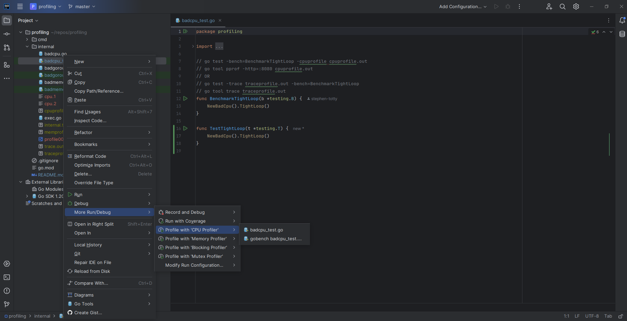
Profiling tests with Goland
Goland uses pprof under the covers
“Click on test file” -> ”More Run/Debug” -> “Profile With …”

Slide 9
Embedding profile creation
Profiles in "runtime/pprof“ // returns *pprof .Profile
pprof.Lookup("goroutine").WriteTo(f, 0)
pprof.Lookup("threadcreate").WriteTo(f, 0)
pprof.Lookup("heap").WriteTo(f, 0)
pprof.Lookup("allocs").WriteTo(f, 0)
pprof.Lookup("block").WriteTo(f, 0)
pprof.Lookup("mutex").WriteTo(f, 0)
Special functions in "runtime/pprof"
pprof.StartCPUProfile(f) and pprof.StopCPUProfile()
pprof.WriteHeapProfile(f)

Slide 10
Embedding profile creation (cont)
Special functions in "runtime"
runtime.SetMutexProfileFraction(100)
runtime.SetBlockProfileRate(100000000)
Special functions in "runtime/trace“
trace.Start(traceFile) and trace.Stop()

Slide 11
Embedding profile endpoint
_ "net/http/pprof“
Add the following code:
go func() {
log.Println(http.ListenAndServe("localhost:6060", nil))
}()
Visit http://localhost:6060/debug/pprof/

Slide 12
Resources
Go Diagnostics https://go.dev/doc/diagnostics
Profiling Go Programs https://go.dev/blog/pprof
Testing flags https://pkg.go.dev/cmd/go#hdr-Testing_flags
Runtime pprof https://pkg.go.dev/runtime/pprof
Web pprof https://pkg.go.dev/net/http/pprof
Go tools (see cmd) https://pkg.go.dev/golang.org/x/tools
Dave Cheney talk https://www.youtube.com/watch?v=nok0aYiGiYA
Dave Cheney workshop https://dave.cheney.net/high-performance-go-workshop/dotgo-paris.html
Brad Fitzpatrick (2015) https://www.youtube.com/watch?v=xxDZuPEgbBU
DataDog https://github.com/DataDog/go-profiler-notes/blob/main/guide/README.md
Goland (jetbrains) https://blog.jetbrains.com/go/2023/02/02/profiling-go-code-with-goland/
Older Goland https://blog.jetbrains.com/go/2019/04/03/profiling-go-applications-and-tests/
Infoq https://www.infoq.com/articles/debugging-go-programs-pprof-trace/

Slide 13
My repo
Visit https://github.com/stephen-totty-hpe/profiling
Code samples
This presentation

Slide 14
Questions

Slide 15
Thank you

